Slide 1
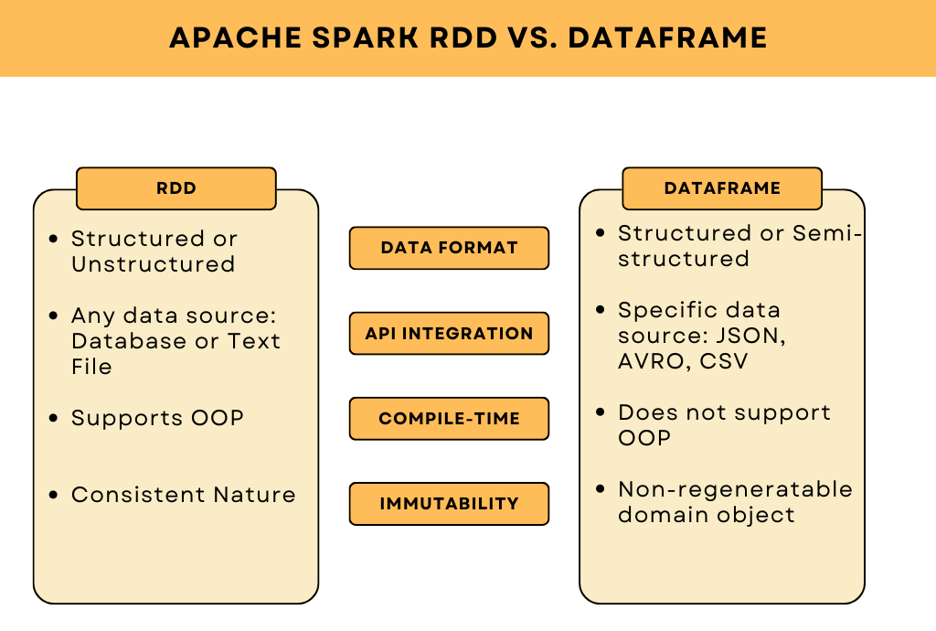

Slide 2
PySpark
Demo

Slide 3
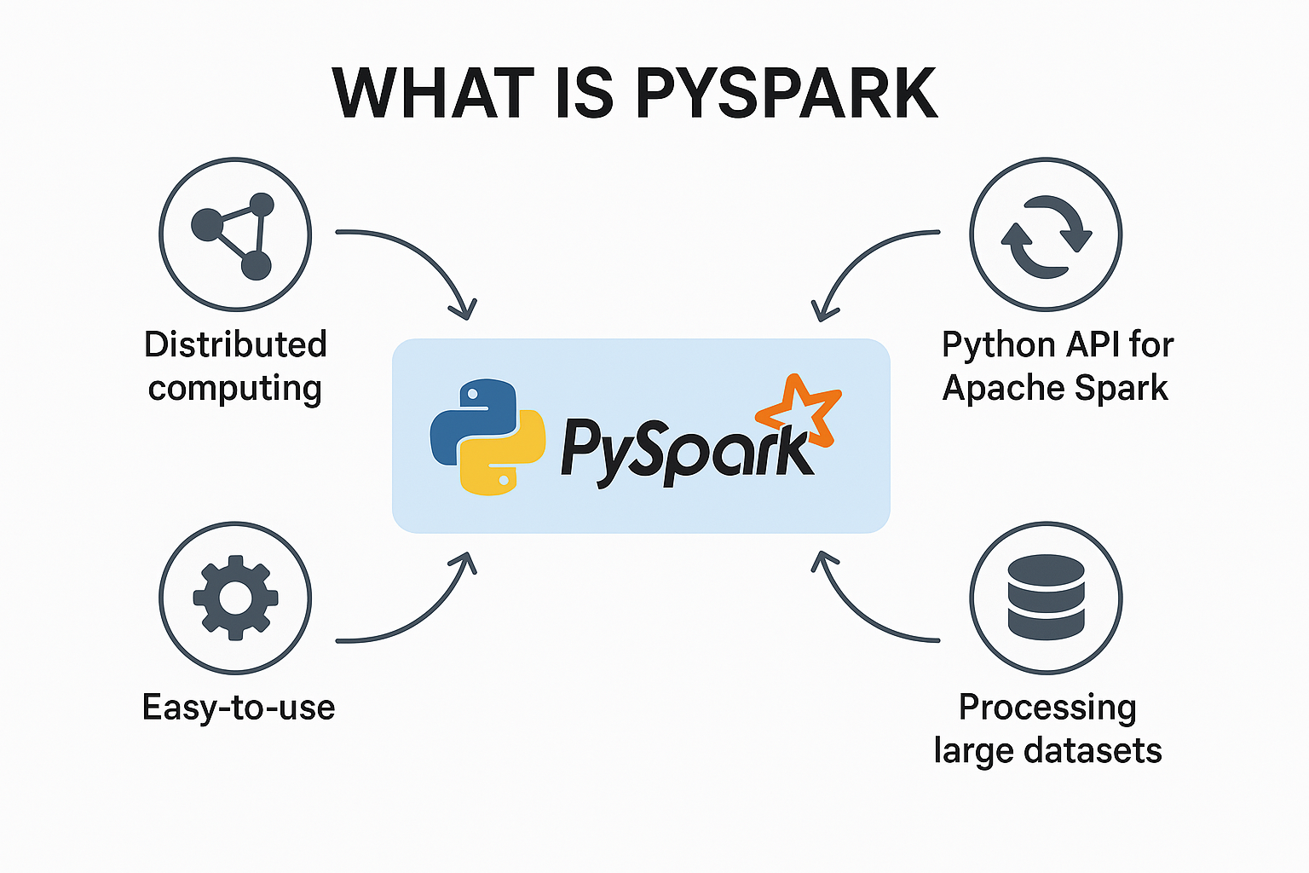
What is PySpark
Python API for Apache Spark
Distributed processing with RDDs & DataFrames
Lazy evaluation & DAG-based execution
In-memory speed & automatic fault tolerance
Built-in MLlib, Structured Streaming, GraphX
Scales from a single laptop to large clusters

Slide 4
Why use PySpark
Python + Spark Power: Combines the simplicity of Python with the distributed computing capabilities of Apache Spark.
Scalability: Handles massive datasets effortlessly—from gigabytes to petabytes—across many machines.
Speed: Executes tasks in memory, making it much faster than disk-based engines like Hadoop MapReduce.
Flexible APIs: Offers both low-level (RDD) and high-level (DataFrame, SQL) APIs for data manipulation.

Slide 5
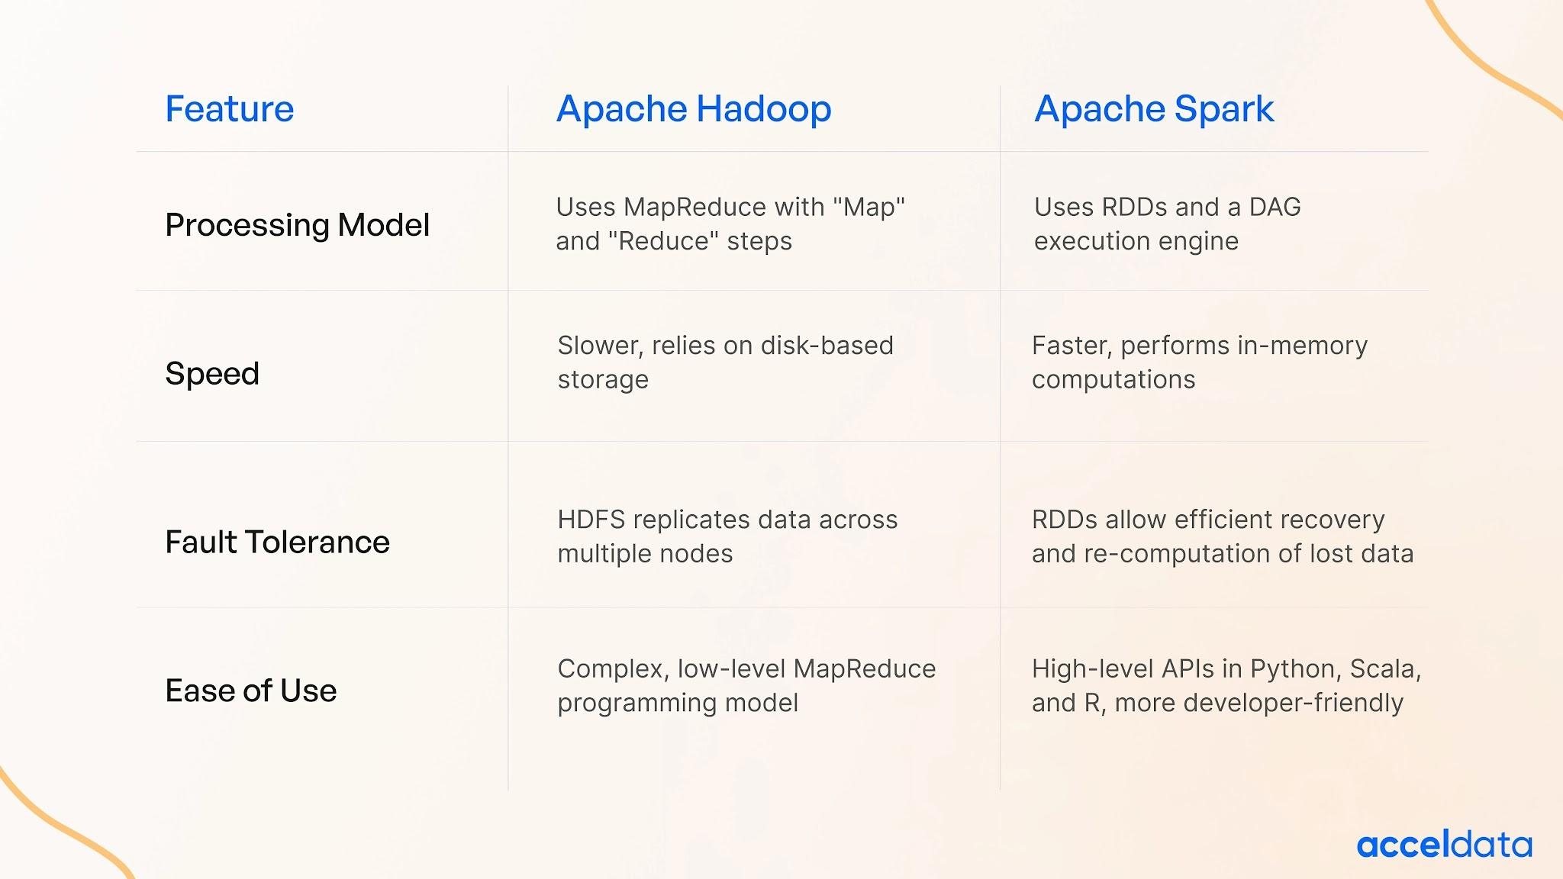

Slide 6
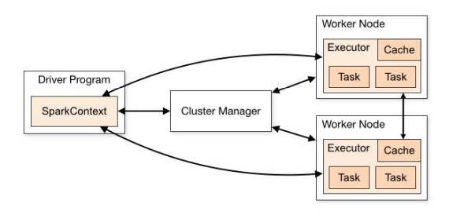
Spark Architecture Overview
Driver Program: The process to start the execution (main() function)
Cluster Manager: An external service to manage resources on the cluster (standalone manager,YARN, Apache Mesos)
Worker Node : Node that run the application program in cluster
Executor :
Process launched on a worker node, that runs the Tasks
Keep data in memory or disk storage
Task : A unit of work that will be sent to executor
Job
Consists multiple tasks
Created based on a Action
Stage : Each Job is divided into smaller set of tasks called Stages that is sequential and depend on each other

Slide 7
What is RDD
Resilient Distributed Datasets (RDD) is a fundamental data structure of Spark. It
is an immutable distributed collection of objects. Each datasets in RDD is divided
into logical partitions, which may be computed on different nodes of the cluster.
When to Use RDDs
You need fine-grained control over data and transformations.
You're working with unstructured data or custom processing logic.
You want to manually manage partitions or optimize performance at a low level.

Slide 8
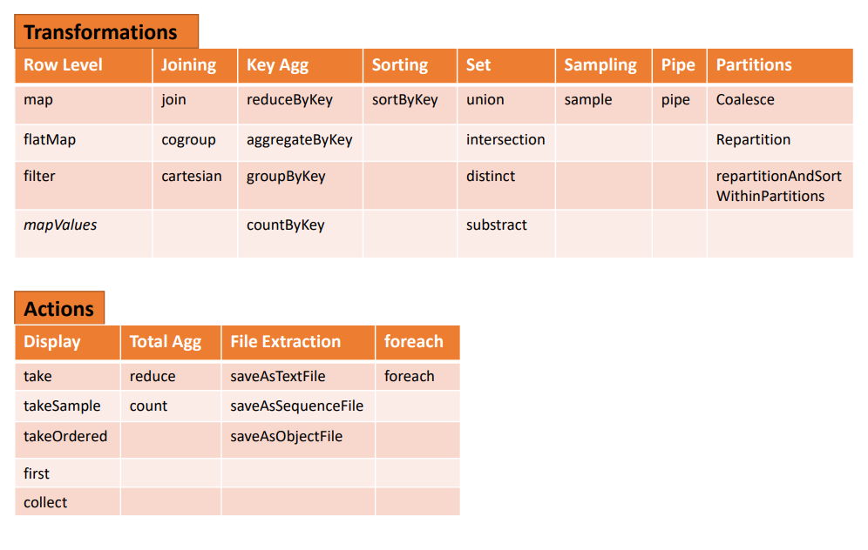

Slide 9
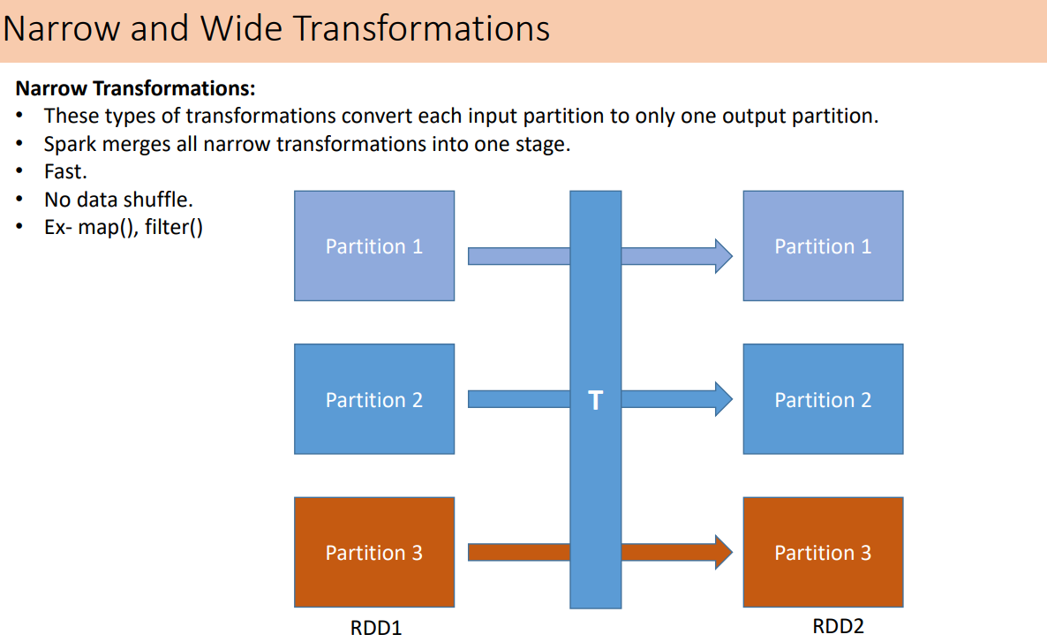

Slide 10
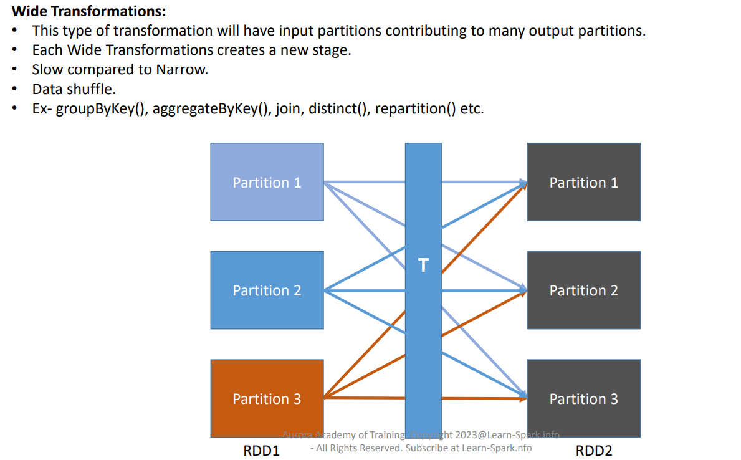

Slide 11
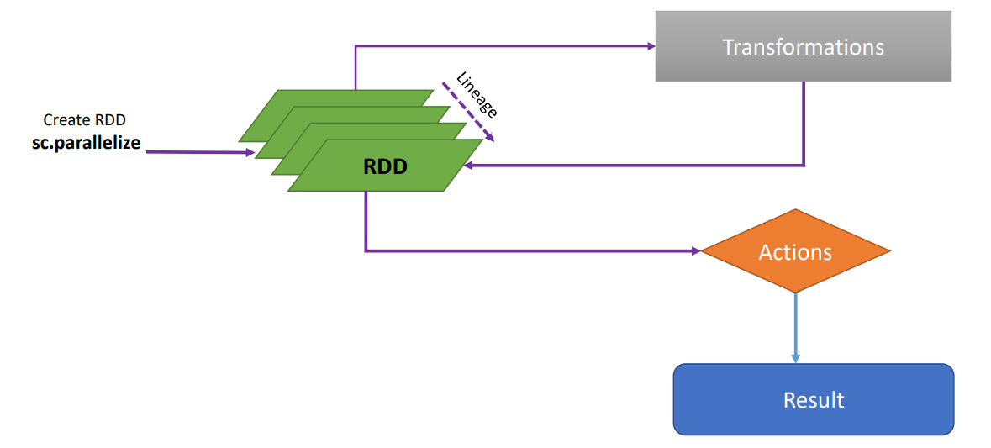
Features of RDD
Fault Tolerance
RDDs track data lineage information to recover lost data quickly and automatically on failure at any point of execution cycle.
Spark keeps a record of lineage while tracking the transformations that have been performed. If any part of RDD is lost, then spark will utilize this lineage record to quickly and efficiently re-compute the RDD using the identical operations.

Slide 12
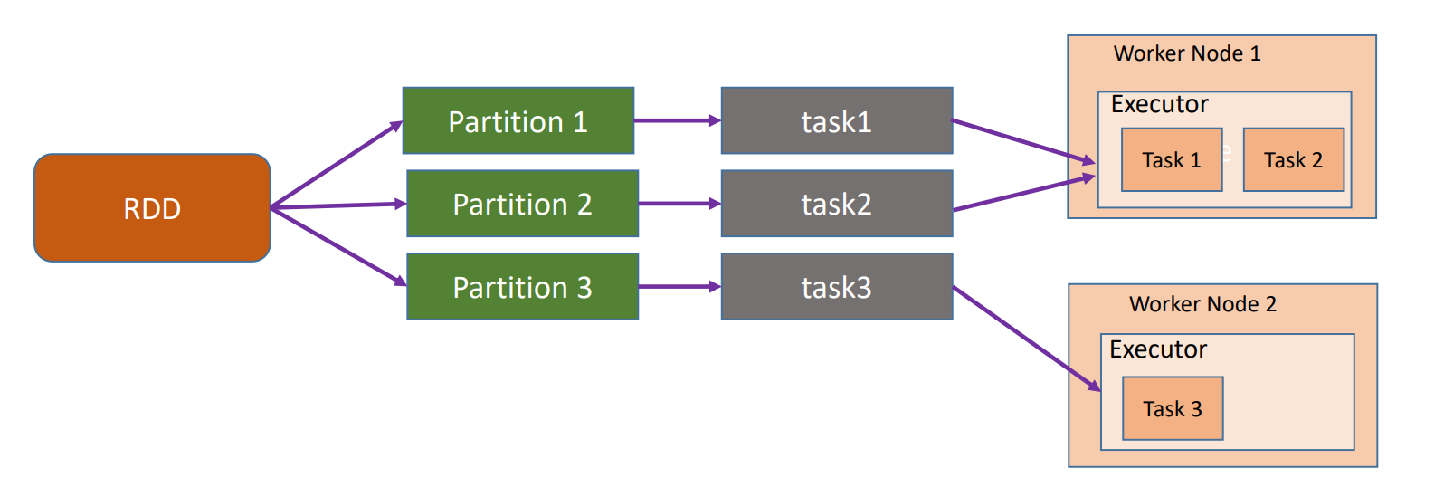
Features of RDD
Distributed
RDD will be divided into partitions while data being processed. Each partition will be processed by one task.
If spark is running in YARN cluster, the number of RDD partitions is typically based on HDFS block size which is 128MB by default. We can control the number of minimum partitions by using additional arguments while invoking APIs such as textFile.

Slide 13
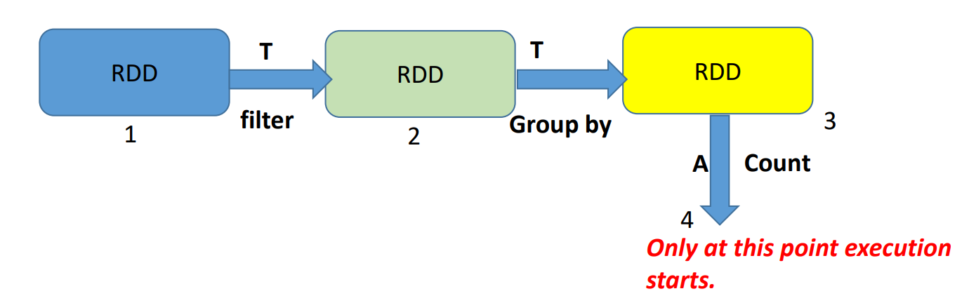
Features of RDD
Lazy Evaluation:
Each Transformation is a Lazy Operation. Evaluation is not started until an action is triggered.

Slide 14
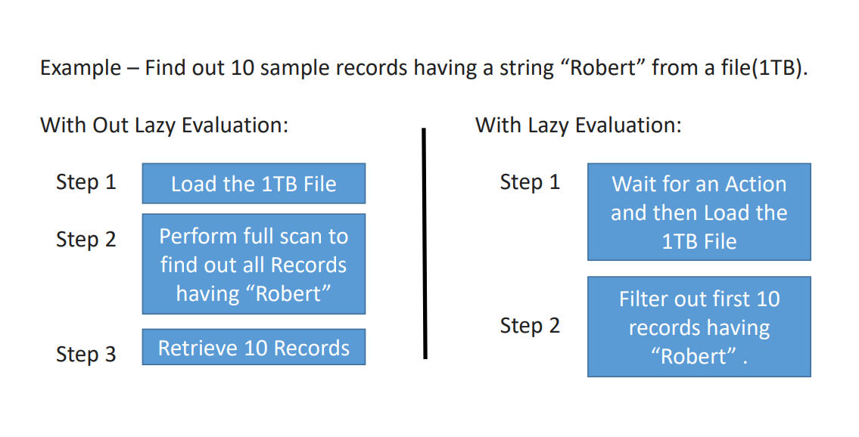
Features of RDD

Slide 15
SparkContext vs SparkSession
SparkContext in PySpark
SparkContext is the entry point to Spark's core engine.
It connects the driver program to the cluster manager (e.g., YARN, Kubernetes, Mesos).
Responsible for requesting resources and launching executors on worker nodes.
All Spark jobs begin with the driver program calling main(), where SparkContext is initialized.
It manages:
RDD creation and lineage
Job scheduling and task distribution
Broadcast variables and accumulators

Slide 16
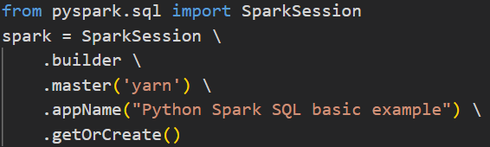
SparkSession: Unified Entry Point (Since Spark 2.0)
Introduced in Spark 2.0 as a single entry point for RDDs, DataFrames, SQL, Streaming, and ML.
Replaces older APIs:
SparkContext → RDDs, Accumulators, Broadcasts
SQLContext → DataFrames, SQL
HiveContext → SQLContext + Hive support
SparkSession internally creates and exposes SparkContext via spark.sparkContext.
In Spark Shell (2.x+), spark is available by default. (sc was used in Spark 1.x.)
Master can be yarn, mesos, Kubernetes or local(x) , x > 0
Access SparkContext via spark.sparkContext

Slide 17
Spark Execution Engine
The Spark Execution Engine is the core runtime component that takes optimized logical plans (from DAG and Catalyst) and turns them into actual distributed execution on a cluster.
It manages:
Job Scheduling
Stage Creation
Task Execution
Resource Allocation
Core components of the execution engine include:
DAG Scheduler
Task Scheduler
Cluster Manager
Executors

Slide 18
Action Triggered → Job Created
A job is triggered when an action is called: Examples: .collect(), .show(), .count(), .write()
Spark does not execute until an action is called (lazy evaluation).
One Spark job = one DAG = one execution plan

Slide 19
DAG (Directed Acyclic Graph)
A DAG represents the sequence of operations in a Spark job.
Spark builds a logical execution plan as a DAG of transformations.
What it Means:
Directed → Each operation flows in one direction (from one node to the next)
Acyclic → No loops or cycles; you can't return to a previous step.
Graph → Composed of:
Vertices → Represent RDDs or DataFrames
Edges → Represent transformations (e.g., map(), filter())

Slide 20
Steps to Build a DAG
1. User submits an application job to spark.
2. Drivers takes the application and create a Spark Context to process the application.
3. Spark Context identifies all the T and A operations present in the application.
4. All the operations are arranged in a logical flow of operations called DAG (Logical Execution Plan).
5. It stops here if SC doesn’t find any A Operations.
6. If it identifies an A operations, spark submit the Operator DAG to DAG scheduler.
7. DAG Scheduler converts the Logical Execution plan into Physical Execution plan and creates stages and tasks. Here Narrow T are fused together into one stage. Wide T involving shuffle process creates new stages.
8. DAG scheduler bundles all the tasks and send it Task Scheduler which then submit the job to cluster manager for execution.

Slide 21
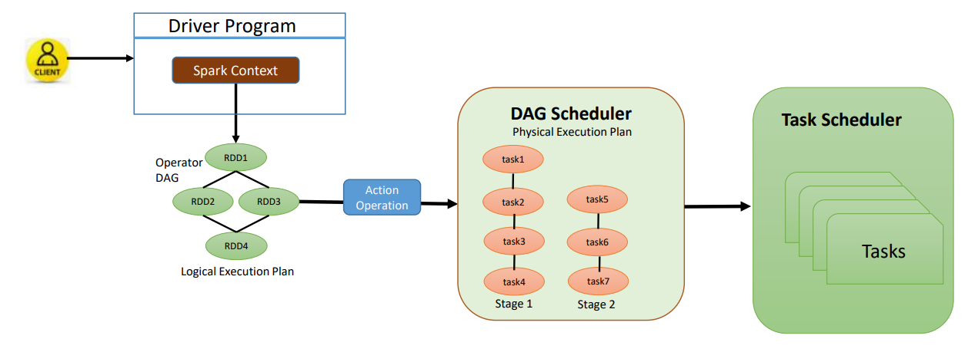

Slide 22
Stages
Stage is a set of operations that can be pipelined together.
Narrow Transformations:
Example: map(), filter()
No data movement across partitions → same stage
Wide Transformations:
Example: groupBy(), join()
Requires shuffling → new stage is created
A job can have multiple stages depending on the logic.

Slide 23
Task Scheduler
Receives ready-to-run stages from the DAG Scheduler.
Breaks each stage into a set of independent tasks (one per data partition).
Assigns tasks to available executors for execution.
Makes scheduling decisions based on:
CPU/core availability
Data locality (to minimize network I/O)
Task retry policy (for fault tolerance)
Stateless: It does not track lineage or data flow — only dispatches and monitors task completion.
Optimized to achieve high throughput and parallelism with minimal overhead.

Slide 24
Tasks
Atomic unit of execution in Spark — smallest work package.
Each task runs the logic of its parent stage on a single data partition.
All transformations within the stage (e.g., map, filter, reduce) are executed inside the task.
Tasks are:
Isolated and parallel across executors
Stateless and re-runnable (supporting fault recovery)
Execution characteristics:
High volume (100s or 1000s per job)
Fast and lightweight (compared to full jobs)
Example: 200 partitions → 200 parallel tasks for that stage

Slide 25
Cluster Manager
Accepts resource request from Driver
Allocates containers / pods / processes on worker nodes
Launches executors and tracks their health
Supported: YARN, Kubernetes, Standalone
Executors
Executors are JVM processes running on worker nodes.
Each executor:
Executes tasks (map, filter, reduce, join, etc.)
Manages memory (caching, shuffling)
Sends results/errors back to Driver
Executors live until application ends or fail

Slide 26
RDD Execution Flow
User Code → RDD Operations
↓
RDD Lineage → DAG (RDD Graph)
↓
DAG Scheduler → Stages
↓
Task Scheduler → Tasks
↓
Cluster Manager → Executors → Tasks run

Slide 27
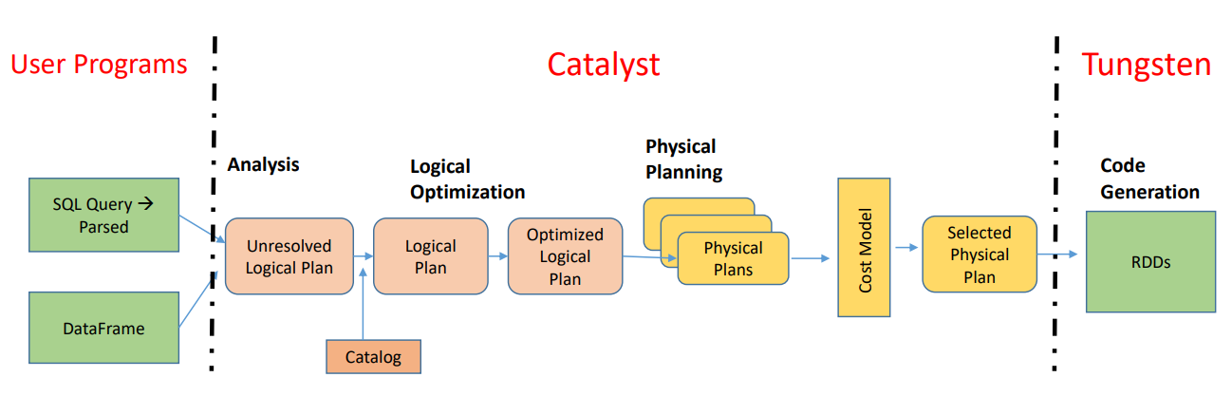
Spark SQL Engine: Catalyst + Tungsten Pipeline

Slide 28
User Program
User writes code using SQL or DataFrame APIs.
Spark doesn’t run this immediately.
Instead, it builds a logical plan to understand what needs to be done.
Catalyst Optimizer
Catalyst is a modular query optimizer built on functional programming principles (Scala).
Catalyst has 4 Steps:
Analysis – Understand what you wrote using Catalog (schemas)
Logical Optimization – Rewrites your plan (e.g., filter pushdown)
Physical Planning – Generates multiple execution strategies
Cost Model – Picks the most efficient one

Slide 29
Tungsten – The Execution Engine
Tungsten is Spark's low-level execution engine, introduced in Spark 1.4 and improved in 2.x+. It Runs the plan Catalyst created, but with high performance.
Focused on CPU and memory efficiency
Avoids overhead of older execution models (Volcano)
Uses whole-stage code generation to convert stages into Java bytecode
Key Benefits:
Reduces memory usage
Runs faster by avoiding intermediate data
Uses modern CPU features (SIMD, pipelining)

Slide 30
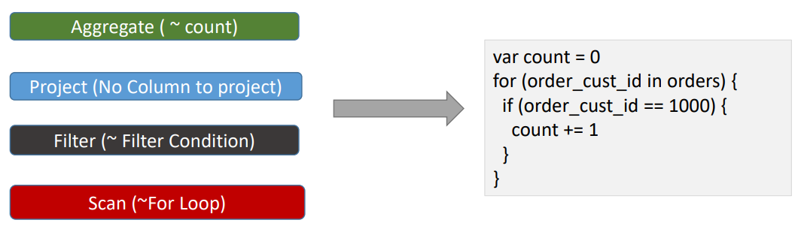
Whole-Stage Code Generation (Spark 2.x)
Spark compiles chains of operations into a single function
This makes the code run like hand-written, optimized Java
Example: filter → select → groupBy is fused into one compiled unit

Slide 31
DataFrame / Dataset Execution Flow
User Code → DataFrame / Dataset Operations
↓
Unresolved Logical Plan
↓
Catalyst Optimizer → Optimized Logical Plan
↓
Physical Plan (with code generation)
↓
RDDs under the hood → DAG
↓
DAG Scheduler → Stages
↓
Task Scheduler → Tasks
↓
Cluster Manager → Executors → Tasks run

Slide 32
What is Partition
Datasets are huge is size and they cannot fit into a single node and so they have to be partitioned across different nodes or machines.
Partition in spark is basically an atomic chuck of data stored on a node in the cluster. They are the basic units of parallelism.
One partition can not span over multiple machines.
Spark automatically partitions RDDs/DataFrames and distributes the partitions across different nodes.
We can also configure the optimal number of partitions. Having too few or many partitions is not good

Slide 33
How Spark does the default Partitioning of Data ?
Spark checks the HDFS Block size. The HDFS block size for Hadoop 1.0 is 64mb and Hadoop 2.0/YARN is 128MB.
It creates one partition for each block size.
Ex- We have a file of 500MB, so 4 partitions would be created.
At times programmers are required to change the number of partitions based on the requirements of the application job.
The change can be to increase the number of partitions or decrease the number of partitions.
So we would either apply the repartition or coalesce.

Slide 34
Repartition
Repartition(numPartitions):
• Return a new RDD that has exactly numPartitions partitions.
• Create almost equal-sized partitions.
• Can increase or decrease the level of parallelism.
• Spark performs better with equal-sized partitions. If you need further processing of huge data, it is preferred to have equal-sized partitions, and so we should consider using repartition.
• Internally, this uses a shuffle to redistribute data from all partitions, leading to a very expensive operation. So avoid if not required.
• If you are decreasing the number of partitions, consider using coalesce, where the movement of data shuffling across the partitions is lower

Slide 35
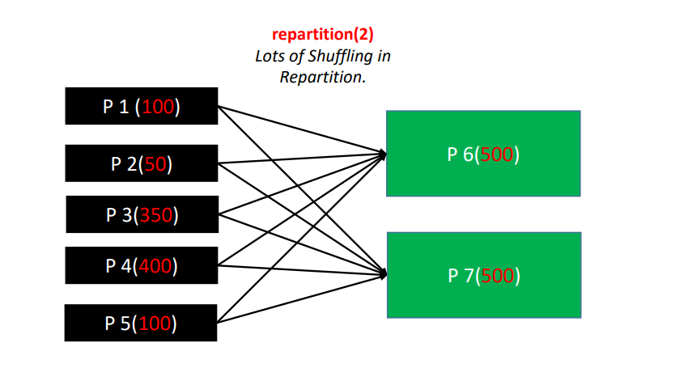

Slide 36
Coalesce
coalesce(numPartitions, shuffle=False):
Return a new RDD that is reduced into `numPartitions` partitions.
Optimized version of repartition().
No shuffling.
Results in a narrow dependency, e.g. if you go from 1000 partitions to 100 partitions, there will not be a shuffle, instead each of the 100 new partitions will claim 10 of the current partitions.
If a larger number of partitions is requested, it will stay at the current number of partitions.
By Default Coalesce can be only used for decreasing the partitions.
But by passing shuffle=True parameter it behaves like repartition and we can increase the partitions as well.

Slide 37
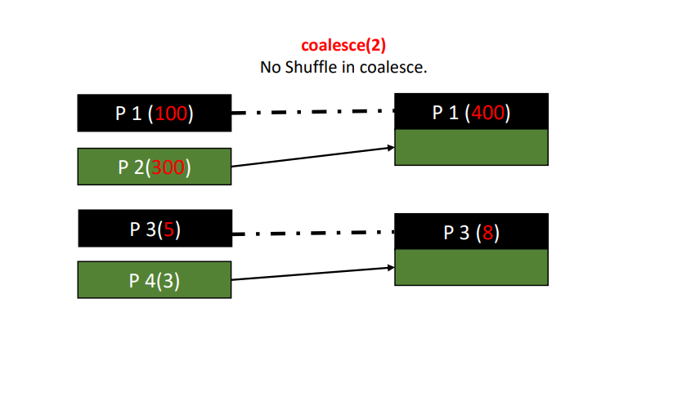

Slide 38
Persistence
One of the most important capabilities in Spark is persisting (or caching) a dataset in memory.
When we persist an RDD, each node stores any partitions of it that it computes in memory and reuses them.
We can mark an RDD to be persisted using the persist() or cache() methods on it. The first time it is computed in an action, it will be kept in memory on the nodes.
Spark’s cache is fault-tolerant – if any partition of an RDD is lost, it will automatically be recomputed using the transformations that originally created it.
Each persisted RDD can be stored using different storage level. These levels are set by passing a StorageLevel object

Slide 39
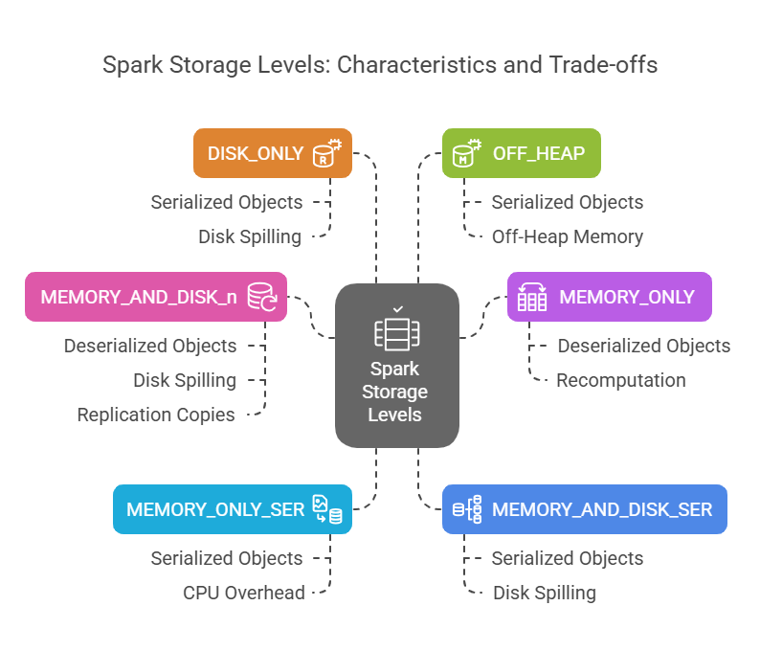

Slide 40
Join Strategies in PySpark
Broadcast Hash Join
Shuffle Sort Merge Join
Shuffle Hash Join

Slide 41
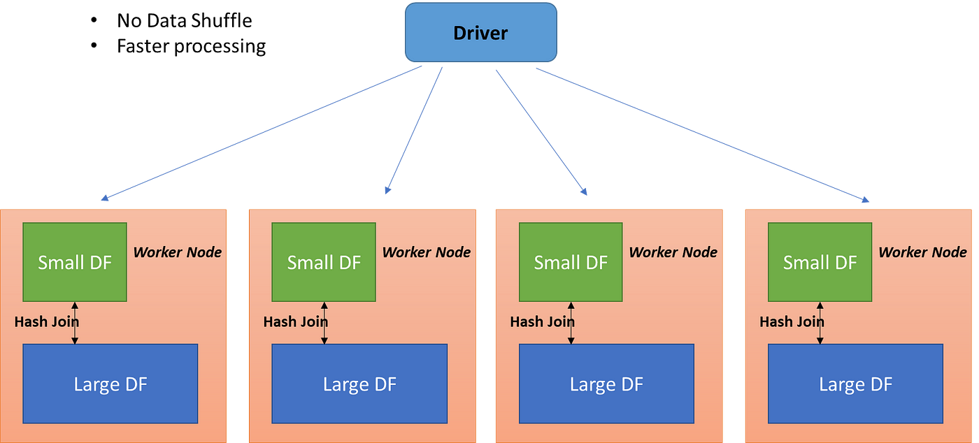
Broadcast Hash Join

Slide 42
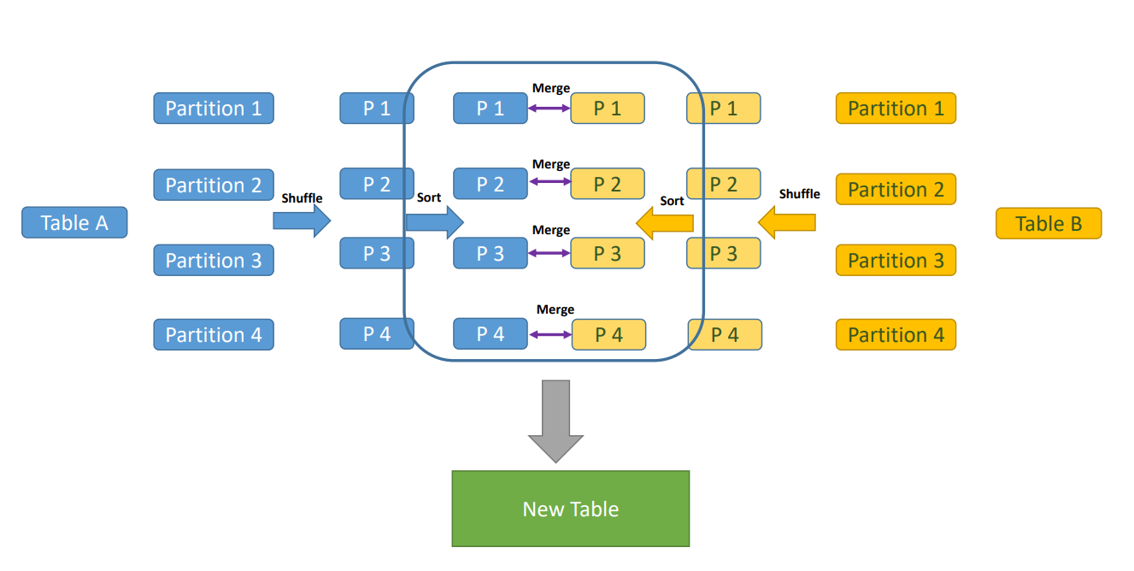
Shuffle Sort Merge Join

Slide 43
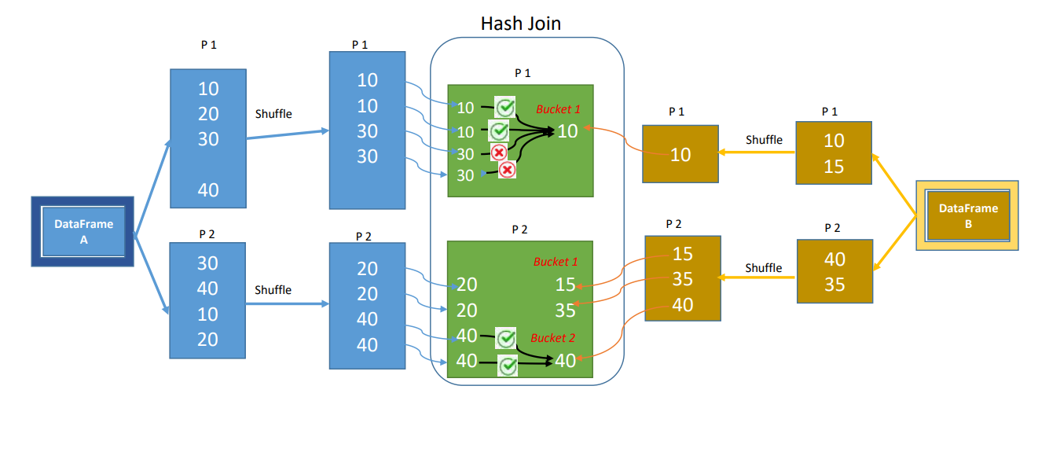
Shuffle Hash Join

Slide 44
Dynamic Resource Allocation
Dynamic Resource Allocation in PySpark is a feature that allows Spark to automatically scale the number of executors (workers) up or down during runtime, based on the workload.
There are three main components involved:
Driver: Orchestrates the application, schedules tasks, and decides when to add or remove executors.
Cluster Manager (like YARN, Kubernetes, or Standalone): Allocates executors on request from the driver.
Executors: Actually run the tasks on worker nodes.

Slide 45
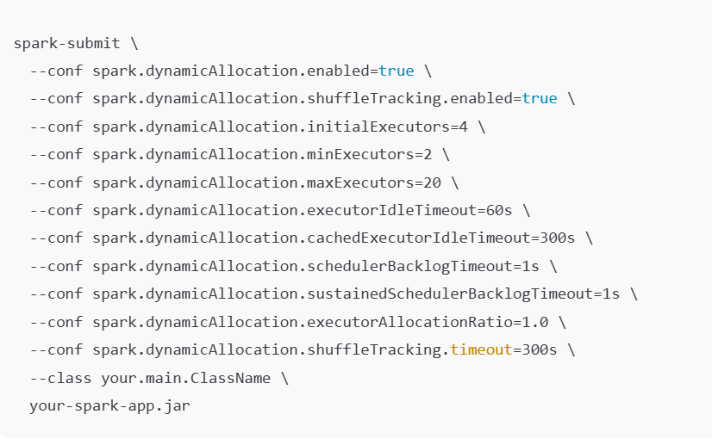
Spark Submit

Slide 46
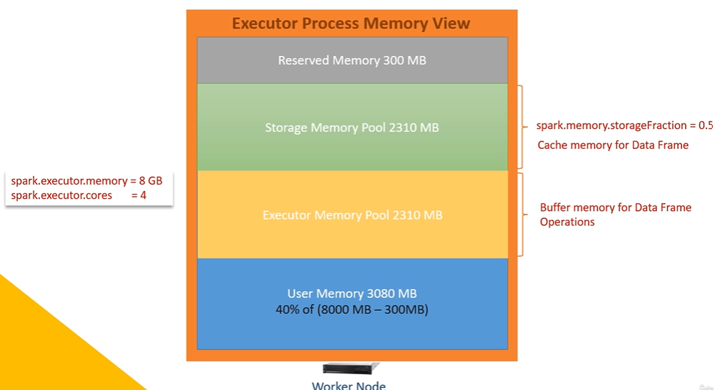

Slide 47
Driver Out of Memory
A "driver out of memory" error in Apache Spark typically occurs when the driver program, responsible for orchestrating the Spark application, is allocated insufficient memory to store metadata or results, leading to the application's failure.
Common cause of this error:
Collecting large amounts of data to the driver
Large broadcast variables.
Insufficient driver memory configuration
Driver overhead

Slide 48
Executor Out of Memory
An "Executor Out of Memory" error in Apache Spark indicates that the memory allocated to a Spark executor is insufficient to process the data assigned to it.
Insufficient Executor Memory
Data Skew
Large Data Shuffles
Memory leaks
Incorrect Configuration

Slide 49
Salting
Some keys (like "India" or "USA") appear disproportionately more often than others.
In Spark, this causes uneven partitioning and a hotspot in one executor.
Example: "India" → 1 million records
"Brazil" → 1,000 records
"Spain" → 500 records
During joins or groupBy, all "India" rows go to one partition, overloading it.
Other partitions finish quickly → one task delays the entire stage.

Slide 50
What is Salting?
Salting is a technique to spread out skewed keys by appending a random or systematic suffix to them — artificially balancing the data distribution.
Each India_# is treated as a separate key → goes to different tasks/executors.
Before Salting: India → India → India → India → India → [sent to one executor]
After Salting:
India_0 → India_1 → India_2 → India_3 → [sent to multiple executors]

Slide 51
How to do Salting?
Identify skewed keys using .groupBy("key").count().orderBy(desc("count"))
On the larger DataFrame (left side of join):
Duplicate skewed rows n times
Add a random salt value (e.g., 0 to 9)
On the smaller DataFrame (right side):
Add all possible salt values for each skewed key
Explode the salt column to match all variants
Join on key_salted = key + "_" + salt

